Slide 1

Introduction to DSLA Methods
Welcome to Bootcamp in R
Rohit Padebettu

Slide 2
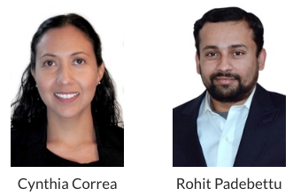
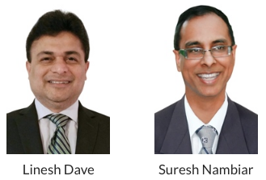


Our Team

Slide 3
Agenda for the Day
Morning Session
Afternoon Session
Introduction to DSLA
Overview of Data Science
Student Introductions
DSLA Methods
Short Break
Course Structure Discussion
Assignments
Introduction to Machine Learning
Introduction to Linear Regression
Short Break
Instructor Case Demo
DSLA Website & Tools Workshop

Slide 4
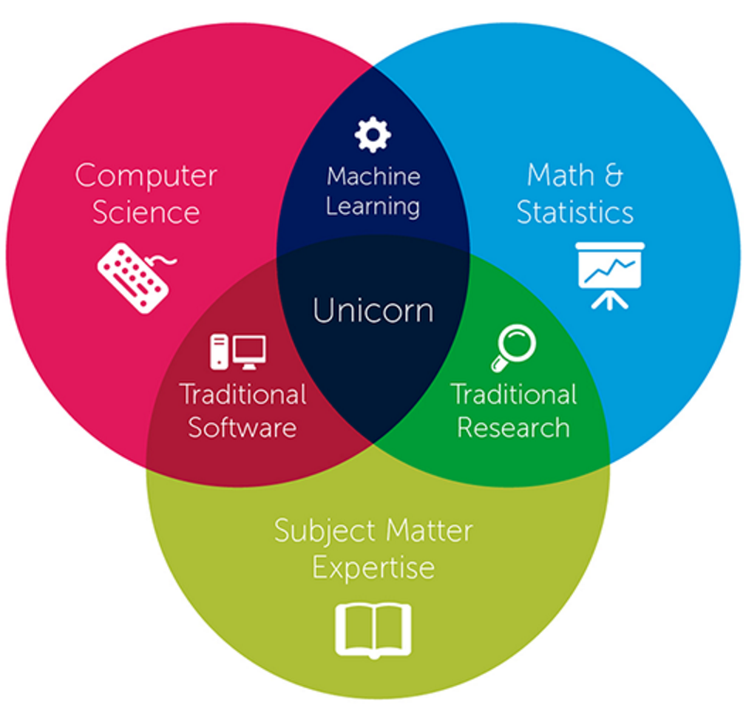
Who is a Data Scientist?

Slide 5
What do Data Scientists do?
Obtain the data
Clean the data
Explore the data
Seek to understand the data
Build models to explain the data
Predict using the models
Report the results

Slide 6
Student Introductions
1. Name
2. What attracted you to data science?
3. What is your professional background?
4. Which of the target skills will challenge you most?
5. Which one comes most naturally to you?
6. Hobby
7. Name
Walk to the front of the class

Slide 7
Current state of Data Science
Many good online courses
Most of these focus on
Many university offered classroom courses
Technical tools
Heavy in Statistics and Math
Almost always work on clean, tidy data
Many more private classroom courses
Lots of freely available material online too !!
All this is necessary, but not sufficient!

Slide 8
DSLA Courses
Our Goal
Building Skills which are Marketable and Enduring

Slide 9
Student Introductions
1. Name
2. What attracted you to data science?
3. What is your professional background?
4. Which of the target skills will challenge you most?
5. Which one comes most naturally to you?
6. Hobby
7. Name
Walk to the front of the class

Slide 10
Target Skill # 1
Conceptualization

Slide 11
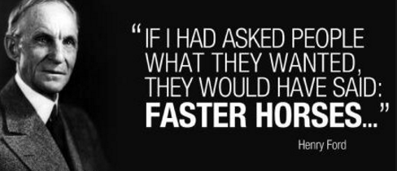
Target Skill # 2
Creative Problem Solving
&
Divergent Thinking

Slide 12
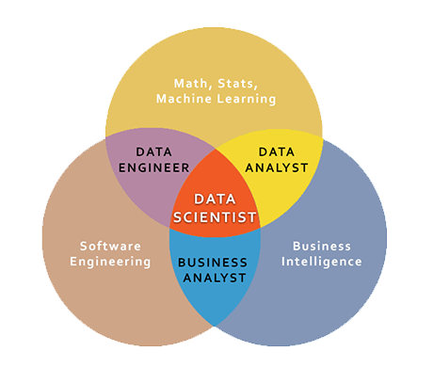
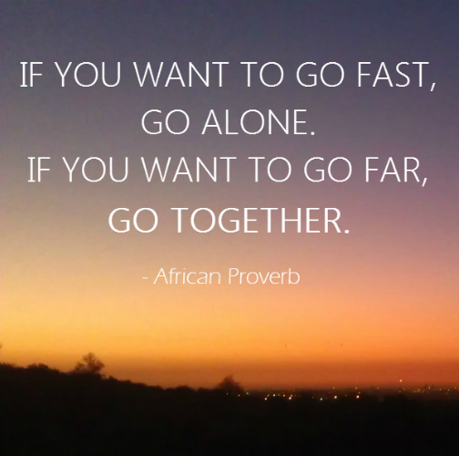
Target Skill # 3
Effective Collaboration

Slide 13
Student Introductions
1. Name
2. What attracted you to data science?
3. What is your professional background?
4. Which of the target skills will challenge you most?
5. Which one comes most naturally to you?
6. Hobby
7. Name
Walk to the front of the class

Slide 14
Target Skill # 4
Iterative Problem Solving

Slide 15
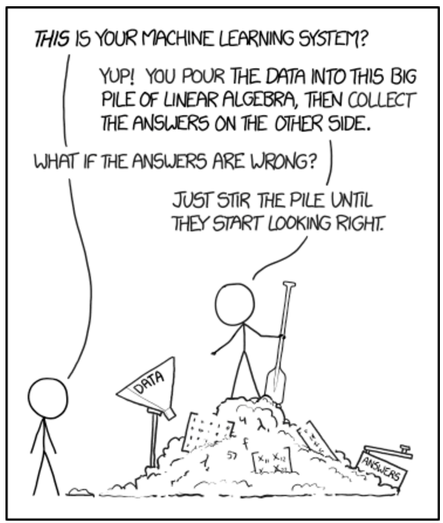
Target Skill # 4
Iterative Problem Solving

Slide 16
Target Skill # 5
Persuasive Communication

Slide 17
Student Introductions
1. Name
2. What attracted you to data science?
3. What is your professional background?
4. Which of the target skills will challenge you most?
5. Which one comes most naturally to you?
6. Hobby
7. Name
Walk to the front of the class

Slide 18
Target Skill # 6
Translation
Analytics to Business

Slide 19
Target Skill # 7
Selling your Ideas

Slide 20
Student Introductions
1. Name
2. What attracted you to data science?
3. What is your professional background?
4. Which of the target skills will challenge you most?
5. Which one comes most naturally to you?
6. Hobby
7. Name
Walk to the front of the class

Slide 21

Training Approach
Team Oriented
Learn by Doing
Social Learning

Slide 22
Your Role
Wear Many Hats

Slide 23
Recent Survey
MIT Sloan Management Review and SAS 5th annual survey of
2,719 business executives, managers and analytics professionals worldwide
What challenges are managers and companies reporting?
Lack Domain Knowledge (34%)
Lack Analytics Skills
(49%)
Analytics insights not translated in business actions
(50%)

Slide 24
We help you Develop
Conceptualization
Iterative Problem Solving
Creative Problem Solving
&
Divergent Thinking
Target Skills
Persuasive Communication
Translation
Analytics to Business
Effective Collaboration
Selling your Ideas

Slide 25
We help you Prepare
Develop Effective Interview Skills
Build a Portfolio of Projects to showcase
Hone Technical Skills in R, Python, Big Data and others
Practice Soft skills such as Report Writing, Presentation, Project Management, Problem Solving

Slide 26

10 minute break You'll need an access card to re-enter the glass doors

Slide 27
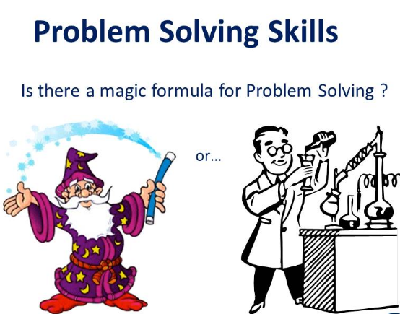
Problem Solving

Slide 28
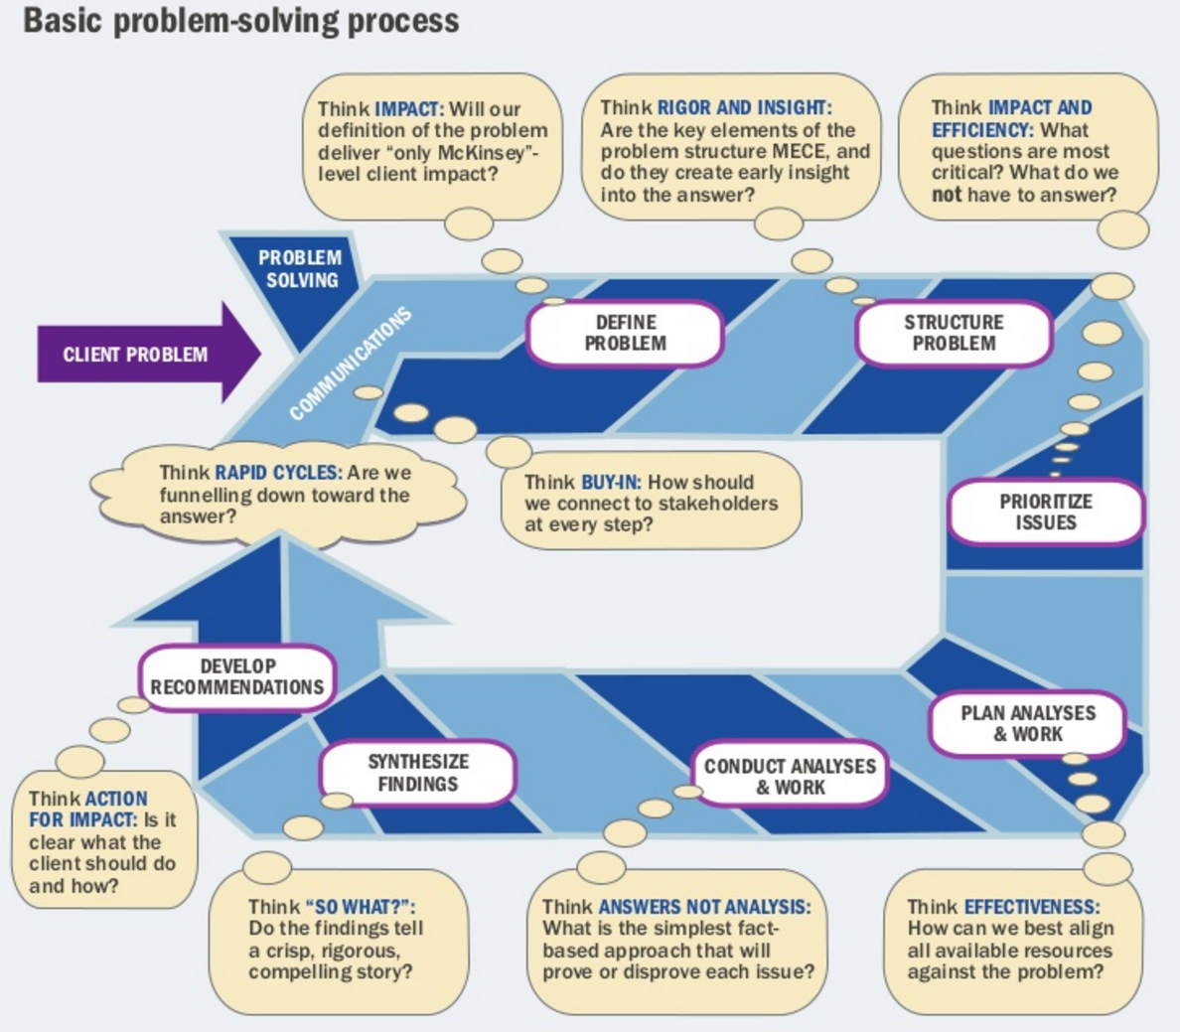
Problem Solving Process

Slide 29
Basic Problem Solving Framework
Ask Right Questions
Guess at the Solution (Hypothesis)
Test the Hypothesis
Analyze, Draw & Report Conclusions

Slide 30
Course Structure
4 or 5 Instructor Led Cases
3 Common Group Projects
1 Elective Group Project
1 Individual Project

Slide 31
Course Assignments
Programming Assignments
Reading Assignments
Presentation Assignments
Technical Skills Assignments
Writing Assignments

Slide 32
Technical Assignment
Install & Familiarize yourself with R and RStudio IDE

Slide 33
Programming Assignment
Install & Complete: Git / GitHub Tutorial
Install & Complete: Swirl – R Programming

Slide 34
Reading Assignment
Read Chapter 1: Introduction
Read Chapter 2: Statistical Learning
Read Chapter 3: Linear Regression
Read Chapter 4: Classification

Slide 35
Writing Assignment
What do you want your Resume to contain in 3 months ?
Create & Submit by Wednesday Aspirational Resume
Two pages maximum
List 3 projects or jobs
Explain the problem
Describe mathematical or statistical techniques used
Specific Metric you Improved

Slide 36
Presentation Assignment
By Tuesday Submit
2 Industries hiring data scientists where you would like to work
2 Types of data science problems they solve
Identify the Algorithms typically used to solve those problems
By Saturday Submit
3 examples of data science problems in your personal/professional life.
For each give
Relevant Question
Hypothesis
Data Source
Algorithm

Slide 37
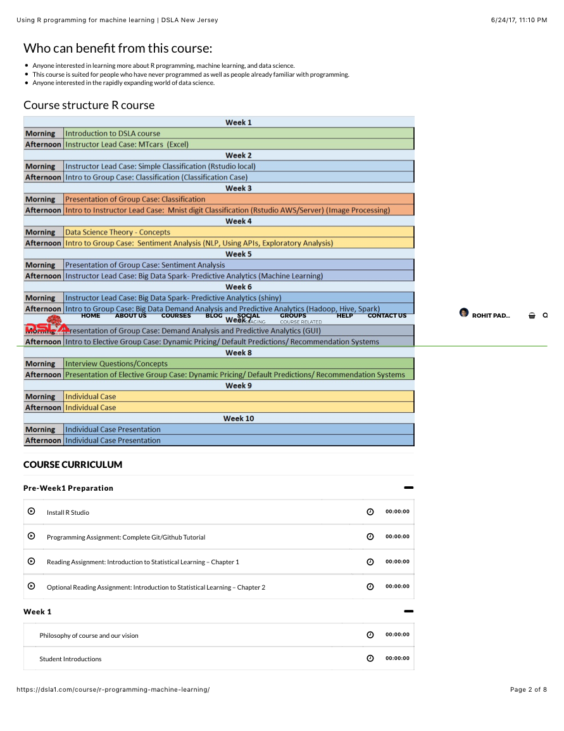
Course Curriculum

Slide 38
60 minute Lunch break You'll need an access card to re-enter the glass doors

